Slide 1


Storytelling Case Study:
Airbnb, NYC
Submitted By:
Avni Shrivastava | Roshani Srivastava | Muna Sahu

Slide 2
Agenda
Objective
Backgrounds
Visualizations
Key Insights &
Recommendation
Appendix
Presentation Title
Submitted By: Muna Sahu, Roshani Shrivastava & Avni Shrivastava

Slide 3

Objective
For the past few months, Airbnb has seen a major decline in revenue. Now that the restrictions have been lifted, Airbnb wants to make sure that it is fully prepared for the change.
To prepare for the next best steps that Airbnb needs to take as a business, we have to analyze a dataset consisting of various Airbnb listings in New York.
Improve our strategy to minimize the economic and commercial effects of Covid-19 on Airbnb, New York City.
When the pandemic hit, we knew we couldn’t pursue everything that we used to. We chose to focus on what is most unique about Airbnb—our core business of hosting. We got back to our roots and understand what is truly special about Airbnb—the everyday people who host their homes and offer experiences.
Provide early recommendations for adjustments in the existing properties to make it more customer-oriented

Slide 4


In the last few months, Airbnb has seen a major decline in revenue due to lockdown imposed during COVID-19 pandemic. It affect the Airbnb Business due to which travel limitations is imposed and because of this Airbnb’s income decreased significantly.
Now that the restrictions are lifted, business should be well prepared to recover the losses incurred.
So, analysis has been done on a dataset consisting of various Airbnb listings in New York.
Background
Submitted By: Muna Sahu, Roshani Shrivastava & Avni Shrivastava

Slide 5
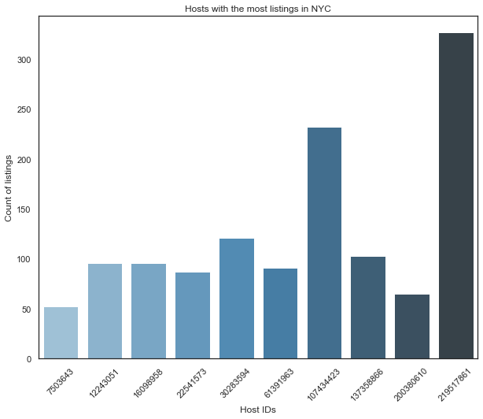
Hosts With Most Listings
From here we can observe that there are 300+ listings with 219517861 ID which has a maximum host listings.
Whereas host with 7503643 ID has a minimum with 50 listing.
Whereas host with 107434423 ID has average with 200+ listing.

Slide 6
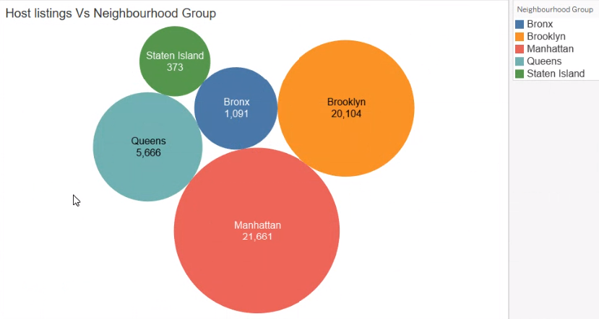
Host Listings in Different Neighborhood Groups
Created a bubble chart between Host listings neighbourhood group just to see which neighbourhood group has the most host listings.
Taken count and distinct count of host listings and count. Manhattan has the highest count of host listings around 21661 and Staten Island has the least count of host listings.

Slide 7
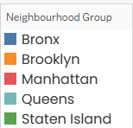
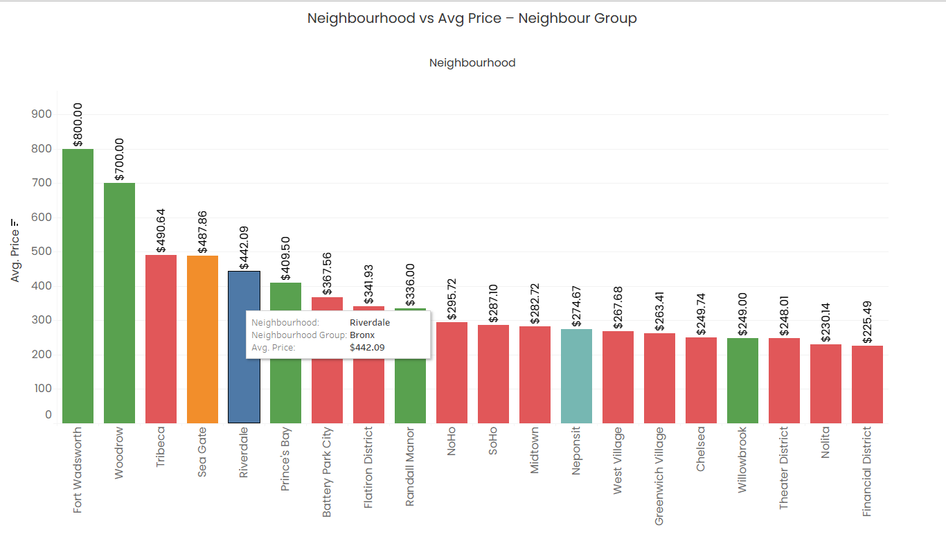
Average Price of Neighbourhood
❖ Top two neighbourhood with highest average price of properties - Fort Wadsworth & Woodrow are in Staten Island.
❖ Manhattan has 12 neighbourhood in the top 20 leading with Tribeca & Battery Park City.
Brooklyn, Queens & Bronx have only
1 neighbourhood each - Sea Gate, Riverdale & Neponsit respectively in the Top 20 category.

Slide 8
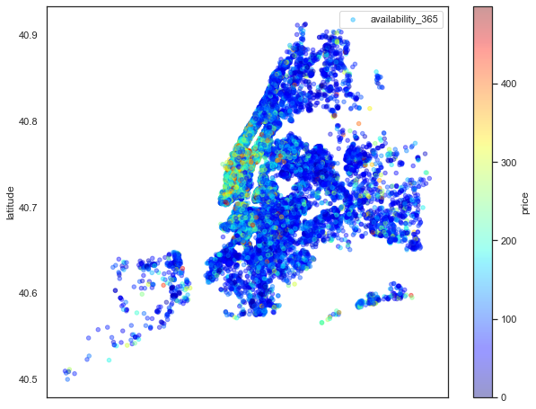
Scatter Plot of Availability
This scatter plot is to depict the longitude and latitude of the areas with available rooms.
We can observe the price range of 200 – 300, at the (-74,40.75) geographic location.

Slide 9
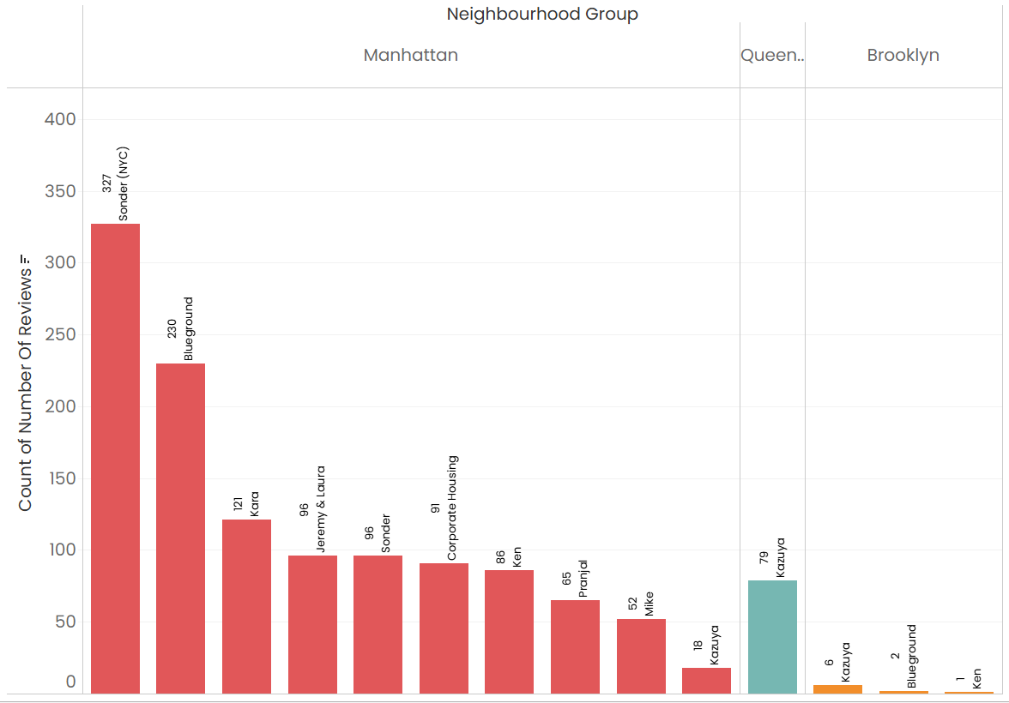
Hosts/ Neighbourhood Group with Maximum Reviews
Majority of reviews are for properties based out of Manhattan. The host Sonder(NYC) has maximum reviews.
Queens and Brooklyn hardly make it to the review list while Staten Island and Bronx are not present at all.
Need to inform the hosts specifically the Non-Manhattan neighbourhood group to ensure receiving reviews since most bookings are based on the reviews.

Slide 10
"Travel as we knew it is over, it doesn't mean travel is over, just the travel we knew is over, and it's never coming back."
- Brian Chesky
CEO of Airbnb
Submitted By: Muna Sahu, Roshani Shrivastava & Avni Shrivastava

Slide 11
Key Insights & Recommendations
Airbnb hosts providing rentals in New York City favour Entire home/apartment and Private room above shared rooms.
Manhattan has the most expensive rental properties followed by Brooklyn , while Bronx and Staten Island have the least expensive
Customer preferences of night stays rises on 14 nights, 30 nights.
Submitted By: Muna Sahu, Roshani Shrivastava & Avni Shrivastava

Slide 12
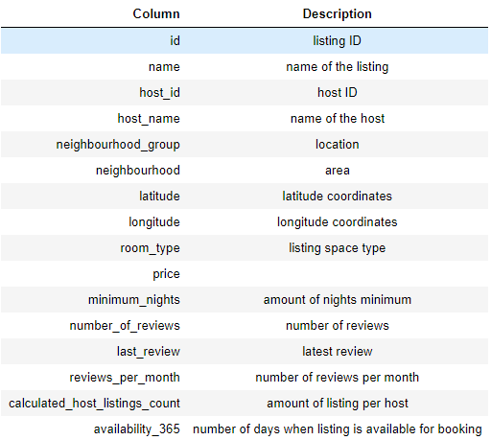
APPENDIX – DATA SOURCE
The New York Airbnb Dataset includes information on various Airbnb listings, including their hosts, locations, pricing, and other characteristics. The dataset's columns are self-explanatory.
We reviewed the dataset description on the right to gain a better understanding of what each column represents.
Submitted By: Muna Sahu, Roshani Shrivastava & Avni Shrivastava

Slide 13
APPENDIX – DATA METHODOLOGY
A thorough analysis of the Airbnb Data was conducted. This process included
Cleaning the data set for missing values and outliers.
Using exploratory data analysis to identify customer preferences based on :
Locality/ Neighbourhood
price
No. of Reviews
Minimum nights stay
Room Type
Host ID/Name
Submitted By: Muna Sahu, Roshani Shrivastava & Avni Shrivastava

Slide 14
APPENDIX - DATA ASSUMPTIONS
In this case study, it is believed that Airbnb was able to reach the targeted level of revenue and profit prior to the implementation of COVID 19, and the data supports this assumption.
The company is not now seeking to expand to additional cities around New York City.
After global COVID-19 limitations are loosened, the business plans will be developed in light of the anticipated increase in travel
Submitted By: Muna Sahu, Roshani Shrivastava & Avni Shrivastava

Slide 15


Conclusion
This dataset for the 2019 year appeared to be a very rich dataset with a variety of columns that allowed us to do deep data exploration on each significant column presented.
We have found hosts that take good advantage of the Airbnb platform and provide the most listings, and that our top host has 327 listings.
We proceeded with analyzing the data and neighborhood listing densities and which areas were more popular than other, and used latitude and longitude columns to create a geographical heat map color-coded by the price of listings.
Submitted By: Muna Sahu, Roshani Shrivastava & Avni Shrivastava

Slide 16




Thank you

